Slide 1
IPL ASSIGNMENT USING TABLEAU
This assignment is to visualize match, team and player statistics based on match related, player related, team related & etc information & create visualization using tableau.

Slide 2
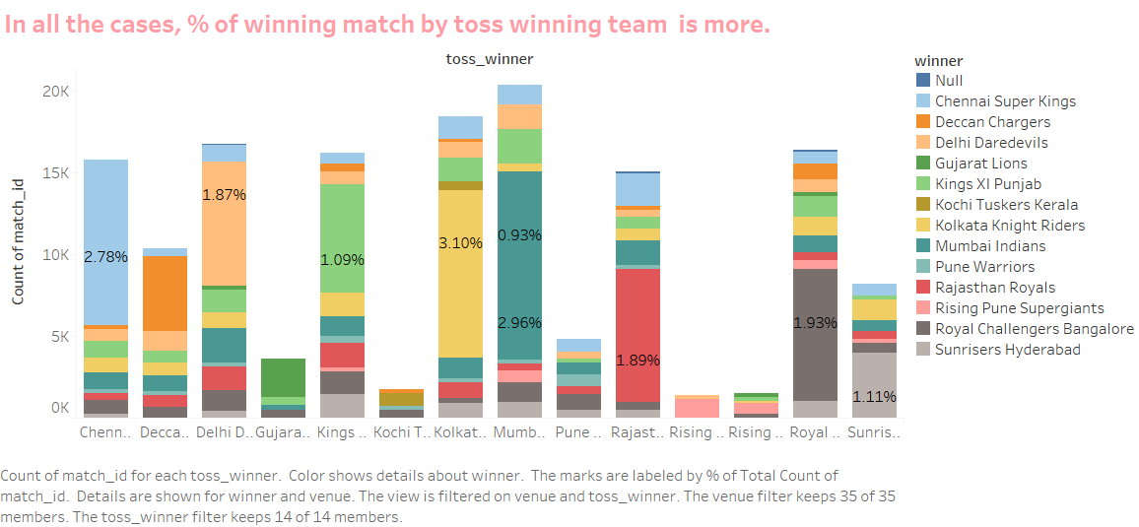
MATCH STATISTICS
Match Vs Toss Outcome
As per bar chart, team who won toss has more chance of winning team.

Slide 3
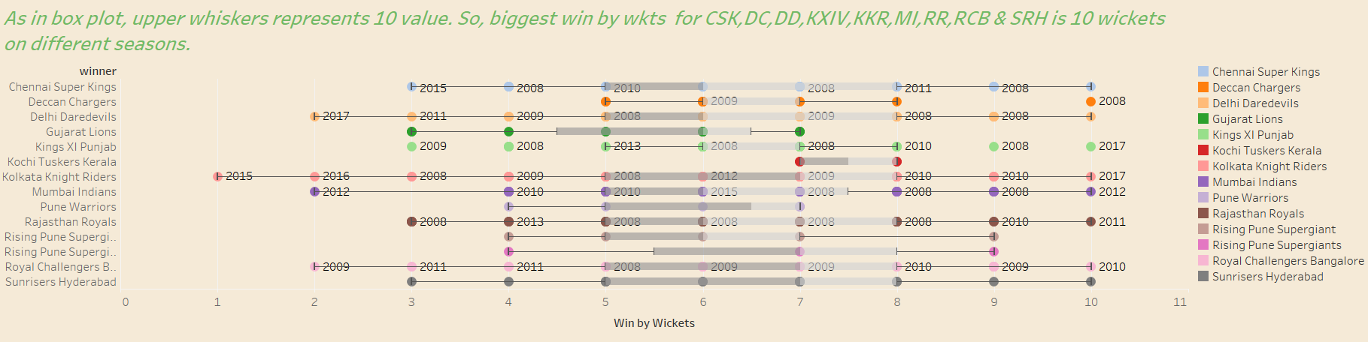
MATCH STATISTICS
Biggest wins (By Wickets)
As per box plot biggest win by wickets is 10 wickets
Notes:
Biggest Win By wickets – As per box plot, biggest win by wickets is 10 wickets by KKR in 2017, MI in 2012 , RR in 2011 , etc

Slide 4
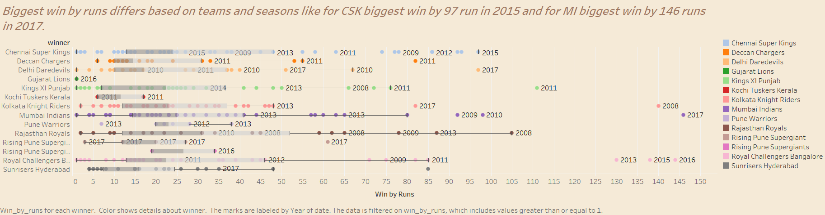
Notes:
Biggest Win by Runs - Biggest win by runs differs based on teams and seasons like for CSK biggest win by 97 run in 2015 and for MI biggest win by 146 runs in 2017.

Slide 5
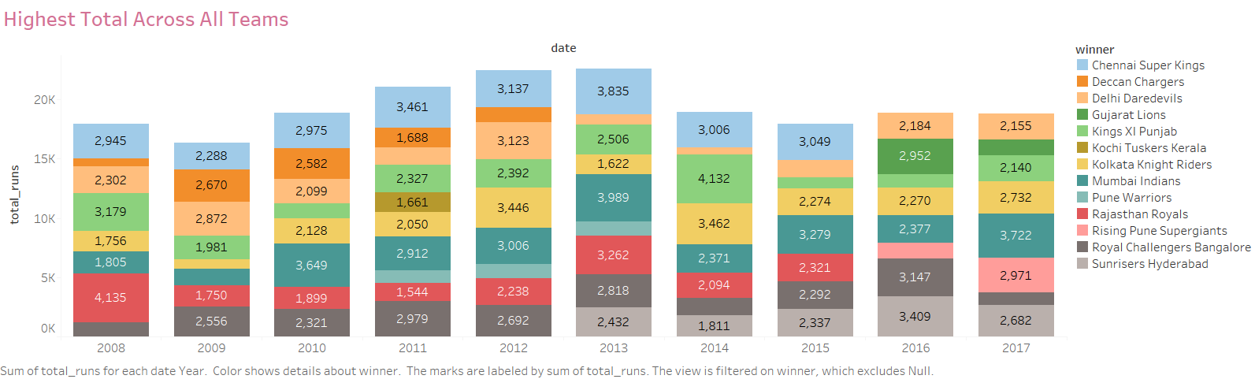
Notes:
Highest Total Across All Teams Season Wise – For 2008, highest total was by RR, 2009 – DD, 2010 – MI , etc

Slide 6
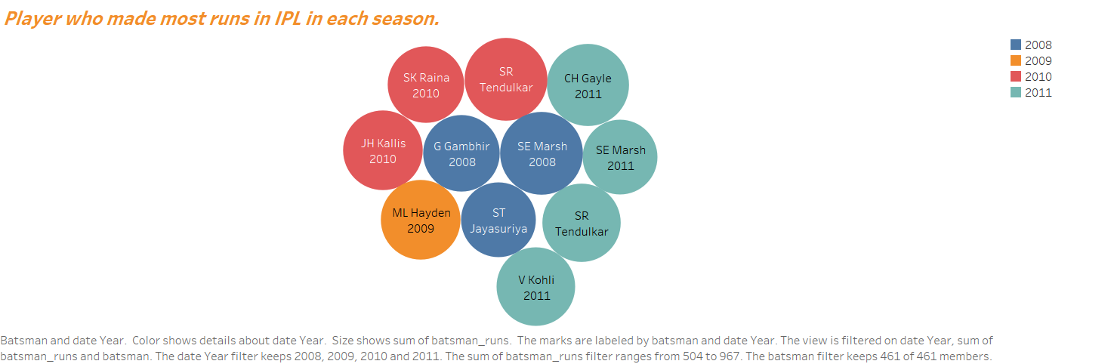
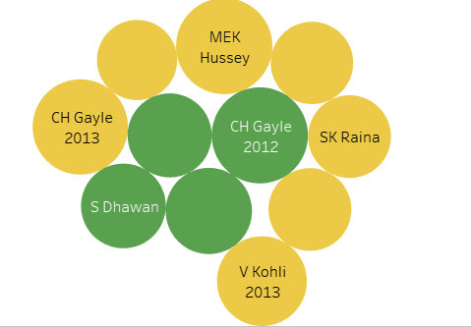
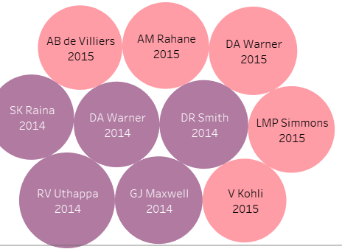
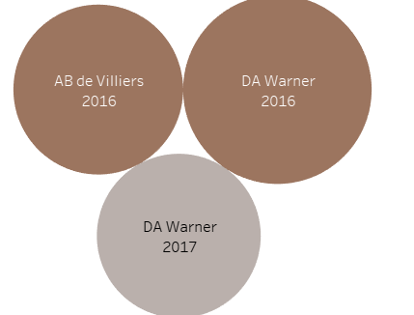
Notes:
Orange Cap Contenders – 2008 – SE Marsh, 2009 - ML hayden, 2010 – Sachin Tendulkar, 2011 – CH gayle, 2012 – CH gayle, 2013 – Mek hussey, 2014 – RV uthappa, 2015 , 2016, 2017 –DA warner

Slide 7
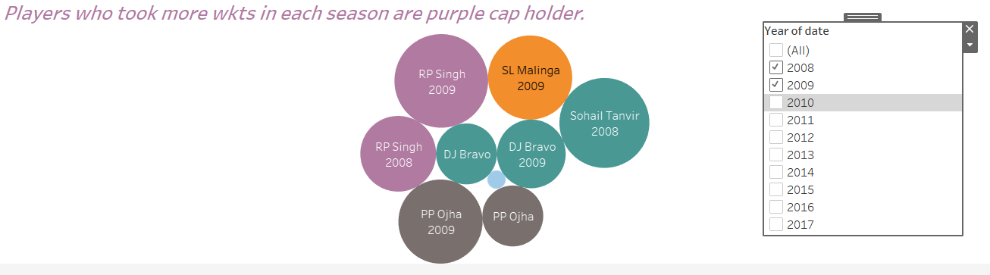
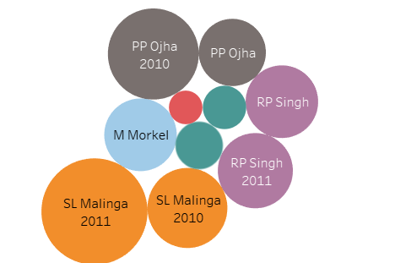
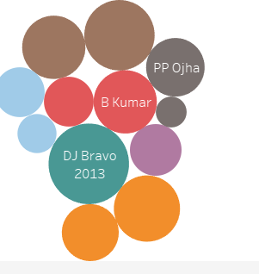
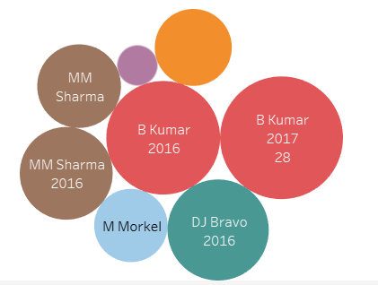
Notes:
Purple Cap Contender – 2008 Sohail Tanvar, 2009 – RP singh, 2010- PP ojha, 2011- SL malinga, 2013 – dj bravo, 2014 – mm sharma, 2016 & 2017 – b kumar.

Slide 8
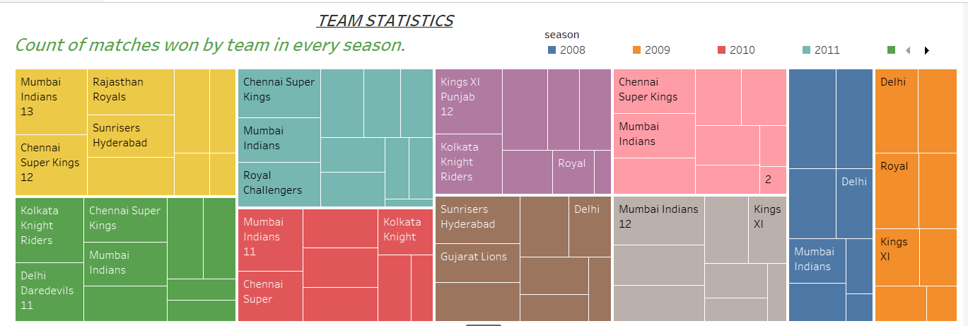
Notes:
Team Statistics – Matches won by team in every season like 2010 – MI won total 10 matches, 2012 – DD won 11 matches ,etc

Slide 9
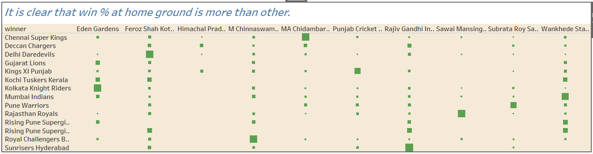
Notes:
Home Advantage – Clear that % of win for team at home ground is more that other.

Slide 10
Thank You!

